Slide 1
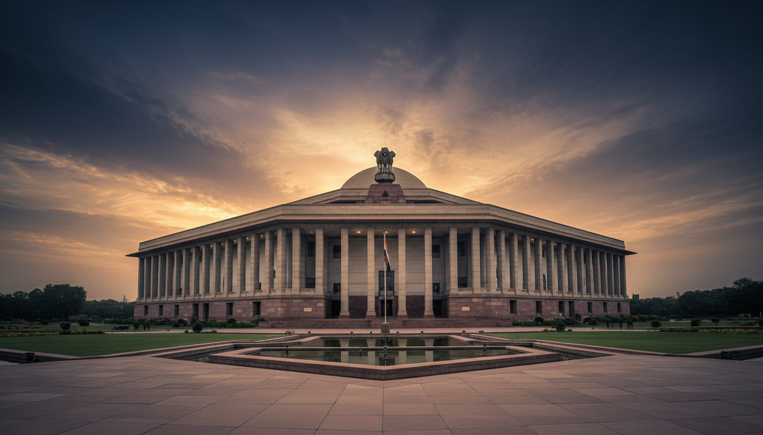
STRATEGIC POLICY BRIEFING
Prepared for:
Classification: For Official Use
PMO | Cabinet Secretariat
NITI Aayog | NSCS
Bharat:
Civilizational State
to Global Knowledge Superpower
Comprehensive National Governance Transformation Analysis
2014–2025 Strategic Review
Total Slides
Analytical Standard
16 Strategic Briefing Slides
Prime Ministerial Briefing Grade

Slide 2
EXECUTIVE SUMMARY
India's Governance Transformation: The Macro Picture
India has undergone the most comprehensive governance transformation in any democracy in recorded history during 2014–2025. This strategic overview presents the foundational shifts across institutional, technological, economic, and social domains.
Scheme Architecture Overhaul
Digital Public Infrastructure Leadership
500+ central government schemes redesigned, launched, or scaled with mission-mode execution, saturation coverage targets, and real-time monitoring capabilities.
DPI has become a global model — UPI, Aadhaar, DigiLocker, CoWIN — with 50+ countries studying or adopting India Stack components.
Anti-Corruption Structural Reform
Defense & Space Excellence
Direct Benefit Transfer (DBT) eliminated intermediary corruption across 300+ schemes, removing 10+ crore fake beneficiaries and saving ₹2.73+ lakh crore .
Defense indigenization moved from ~60% imports to 75% domestic procurement target. Space program achieved global-first milestones including Chandrayaan-3 south pole landing.
Education & Knowledge Systems
Economic Transformation
National Education Policy 2020 represents the first comprehensive education reform in 34 years, integrating Indian knowledge systems with modern pedagogy.
India rose from 142nd to 63rd in World Bank Ease of Doing Business rankings. GDP grew from $1.86T to $3.94T , emerging as the 5th largest economy globally.
Governance Significance: India is transitioning from a developing-nation governance model to a civilizational-state governance architecture with global leadership potential.

Slide 3
GOVERNANCE ARCHITECTURE
Integrated National Governance System
India's governance architecture operates as an integrated multi-tier system with digital infrastructure enabling seamless coordination from constitutional foundations to last-mile delivery.
Governance Hierarchy Flow
Digital Infrastructure Layer
Prime Minister & Cabinet
Identity: Aadhaar
1
1.39 billion enrollments, biometric authentication
Strategic decision-making, policy direction, national priorities
Financial: Jan Dhan
PMO & Cabinet Secretariat
52+ crore bank accounts, universal inclusion
2
Transaction: UPI
Command center, coordination, execution monitoring
13+ billion monthly transactions, real-time settlement
3
Union Ministries & NITI Aayog
Delivery: DBT
Policy formulation, scheme design, sectoral expertise
₹35+ lakh crore transferred, leakage elimination
Monitoring: PRAGATI
4
State Governments
Real-time dashboards, PM-level oversight
Regional adaptation, state-level implementation
5
District Administration
Operational execution, field coordination
Key Integration Points
JAM Trinity: Jan Dhan + Aadhaar + Mobile
6
Local Bodies & Citizens
Cooperative Federalism: 32% to 42% tax devolution
Last-mile delivery, grassroots democracy, beneficiary receipt
Digital Monitoring: PRAGATI + Dashboards

Slide 4
CONSTITUTIONAL FOUNDATIONS
World's Longest Written Constitution as Governance Architecture
Constitutional Architecture
Transformative Amendments
448 Articles, 25 Parts
Fundamental Rights (Part III)
73rd/74th Amendments
Comprehensive governance framework
Enforceable citizen protections
Panchayati Raj & Municipal governance (1992)
Federal Structure with Unitary Bias
Directive Principles (Part IV)
Strong center, autonomous states
State policy guidelines
101st Amendment
GST — unified taxation (2017)
Parliamentary Democracy
Fundamental Duties (Part IVA)
Westminster model adapted to India
Citizen obligations (added 1976)
103rd Amendment
EWS reservation (2019)
Constitutional Bodies
Article 370 Abrogation
J&K structural integration (2019)
Election Commission
CAG
UPSC
Conducts world's largest democratic exercise
Audit and financial oversight
Civil services recruitment
Key Statistics
Adopted: January 26, 1950
Finance Commission
National Commissions
Supreme Court
Length: 448 Articles, 12 Schedules
Tax devolution recommendations
SC, ST, Women, Minorities, OBC
Constitutional guardian
Amendments: 100+ since adoption
Adult Franchise: Universal since 1950
Strategic Significance: The Constitutional framework provides the legal architecture within which all governance transformation operates, and recent amendments reflect structural modernization for 21st-century challenges.

Slide 5
PM GOVERNANCE MODEL
Prime Ministerial Command Structure
The PMO functions as the strategic command center with unprecedented direct monitoring capabilities linking the Prime Minister to implementation at all levels through technology-enabled oversight.
PRAGATI: Direct PM Monitoring
PMO as Command Center
Pro-Active Governance and Timely Implementation — a multimodal platform enabling PM to directly review delayed infrastructure projects, grievance resolution, and program implementation.
Real-Time Dashboards
Live monitoring of all flagship schemes
Cross-Ministry Coordination
PM Gati Shakti: 16-ministry integration
45+ Sessions
₹18+ Lakh Crore
Direct Citizen Connect
Monthly video conferences
Projects reviewed
Mann Ki Baat: 110+ episodes, 100M+ followers
340+ Projects
3-Tier System
Accountability Mechanisms
Individually tracked
PMO → Ministries → States
e-Samiksha: Cabinet decision tracking
Core Governance Principles
NITI Aayog: Strategic Advisory
Technology-first design
Saturation approach
Replaced Planning Commission (2015) with a think tank model focused on bottom-up planning, cooperative federalism, and competitive performance monitoring.
Mission-mode delivery
Data-driven monitoring
Jan Bhagidari
Trust-based governance
Vision 2047: India@100 roadmap
SDG India Index: State-level tracking
Unprecedented Globally: No other major democracy has the head of government directly monitoring individual projects at this frequency and granularity.
Aspirational Districts: 115 backward districts
Sectoral Indices: Health, Education, Water

Slide 6
DIGITAL PUBLIC INFRASTRUCTURE
India Stack: World's Most Comprehensive DPI
India has created the world's most comprehensive Digital Public Infrastructure — a layered architecture that has eliminated intermediaries, reduced corruption, and enabled universal service delivery.
Aadhaar
UPI
DBT
1.39B
13B+
₹35L+ Cr
Enrollments
Monthly Txns
Transferred
100Cr+
₹20L+ Cr
300+
Monthly Auth
Monthly Value
Schemes
Identity Layer: World's largest biometric ID system — 10 fingerprints, 2 iris scans, facial photo. Enables eKYC, DBT delivery, PDS distribution.
Payments Layer: World's most advanced real-time payment system. Interoperable, zero-cost, multi-modal. Global adoption: Singapore, UAE, France, 20+ countries.
Delivery Layer: Direct transfers to Aadhaar-linked accounts. Eliminated 10+ crore fake beneficiaries. Savings: ₹2.73+ lakh crore.
Jan Dhan
DigiLocker
CoWIN
GeM
52+ crore accounts
6+ billion documents
2+ billion vaccinations
₹4+ lakh crore
Global Leadership: India Stack is being studied/adopted by 50+ countries . G20 DPI initiative led by India. World Bank recognizes Aadhaar as global model.

Slide 7
FLAGSHIP SCHEMES
Major Government Schemes: Transformation Impact
Saturation approach with 100% coverage targets — schemes designed to reach every eligible beneficiary, not just a sample, fundamentally transforming service delivery.
Jan Dhan Yojana
Swachh Bharat
Ujjwala Yojana
52+ Crore
10+ Crore
10+ Crore
Bank accounts opened, achieving near-universal financial inclusion
Toilets built, eliminating open defecation nationwide
LPG connections to women in poor households
ODF Plus | Behavioral change | Dignity focus
Health benefits | Time savings | Women empowerment
Avg balance: ₹4,200+ | Deposits: ₹2.2+ lakh crore
PM Awas Yojana
Ayushman Bharat
Jal Jeevan Mission
3+ Crore
55 Crore
15+ Crore
Houses built for urban & rural poor
Beneficiaries covered — world's largest health assurance
Rural tap water connections provided
Pucca houses | Basic amenities | Women's ownership
₹5 lakh coverage | 30,000+ hospitals | Cashless
Har Ghar Jal | Quality water | Time savings
Saubhagya
PM-KISAN
NEP 2020
4.5+ Crore
11+ Crore
First Reform in 34 Years
Electricity connections to rural households
Farmers receiving ₹6,000/year direct income support
Comprehensive education transformation
Universal electrification | 24x7 power goal
Direct transfer | Aadhaar-linked | Income security
5+3+3+4 structure | Indian knowledge systems | Flexibility
Saturation Model: Rather than incremental coverage, achieve 100% coverage of target beneficiaries — shifts governance from annual targets to mission-mode completion.

Slide 8
2014 INFLECTION POINT
Governance Transformation: Before & After
The 2014 mandate represented a democratic inflection point — citizen aspiration for governance excellence translating into structural reform at an unprecedented scale.
Pre-2014: Structural Challenges
Post-2014: Transformation
Corruption & Scams
Structural Anti-Corruption
CPI Rank: 85 | 2G, Coal, Commonwealth scams
DBT: ₹2.73+ lakh crore saved | GST | IBC
Policy Paralysis
Execution Excellence
Decision-making frozen by accountability fears
PRAGATI monitoring | Mission-mode delivery
Economic Fragility
Economic Resurgence
"Fragile Five" | GDP ~4.7% | Inflation 9-11%
Top 5 economy | GDP $3.94T | Fastest growing
Infrastructure Deficit
Infrastructure Acceleration
12 km/day roads | Power deficit 4.2%
28 km/day highways | 150+ airports | 5G rollout
Leakage Problem
Direct Delivery
"Only 15 paise of every rupee reaches beneficiary"
100% beneficiary reach | Zero leakage
2014 Mandate
Governance Philosophy
Core Principle
282 Seats
Minimum Government
Sabka Saath
First single-party majority in 30 years
Maximum Governance
Sabka Vikas

Slide 9
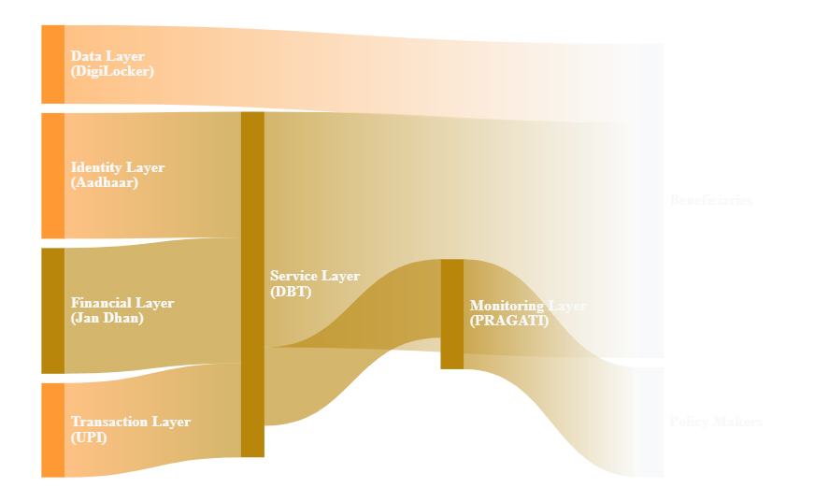
SYSTEMS INTEGRATION
Integrated Governance Operating System
India's governance transformation is built on a seamlessly integrated digital infrastructure where identity, financial, transaction, service delivery, and monitoring layers work in concert to create unprecedented transparency and efficiency.
Integration Points
JAM Trinity
Jan Dhan + Aadhaar + Mobile = Financial inclusion architecture
One Nation One Ration Card
Portable benefits across states via Aadhaar linkage
PM Gati Shakti
16-ministry coordination for infrastructure planning
Real-Time Dashboards
PM monitors all schemes through live data feeds
System Outcomes
10+ crore fake beneficiaries eliminated
₹2.73+ lakh crore leakage prevented
300+ schemes on DBT platform
100% transparent procurement via GeM
Governance Significance: The integrated operating system has created end-to-end transparency — from policy formulation to beneficiary receipt — with real-time visibility at every layer.

Slide 10
CIVILIZATIONAL ROOTS
5,000 Years of Governance Continuity
India's governance transformation draws on civilizational strengths while addressing modern challenges — synthesizing ancient wisdom with cutting-edge systems to create a uniquely Indian governance paradigm.
Arthashastra: Original Governance Science
Knowledge Traditions
Kautilya's treatise (300 BCE) — world's most comprehensive ancient work on statecraft, economics, and governance.
Philosophical Systems (Shaddarshana)
Nyaya, Vaisheshika, Samkhya, Yoga, Mimamsa, Vedanta
Saptanga Theory: 7 pillars of state — maps to modern governance
Revenue Systems: Detailed tax, accounting, auditing frameworks
Mathematical Contributions
Intelligence Networks: Precursor to modern RAW/IB
Zero, decimal system, trigonometry, infinite series
Mandala Theory: Concentric circles of allies — foreign policy
Scientific Traditions
Metallurgy (Iron Pillar), surgery (Sushruta), astronomy
Administrative Evolution
Linguistics: Panini's Ashtadhyayi
Mauryan Empire (322-185 BCE)
World's first formal grammar — foundational to computational linguistics
Centralized bureaucracy, provincial governors, Ashoka's Dhamma
Gupta Empire (320-550 CE)
Modern Synthesis
Decentralized governance, village panchayats, Golden Age
Chola Empire (300 BCE-1279 CE)
Arthashastra anti-corruption → DBT, faceless assessment
Uttaramerur inscription: Democratic village council elections
Chola panchayat → Digital Panchayat governance
Dharmic philosophy → Antyodaya empowerment
Paninian analysis → India Stack architecture
Civilizational-Modern Synthesis: India is not choosing between tradition and modernity — it is synthesizing both to create governance that is culturally rooted yet globally competitive.

Slide 11
PERFORMANCE METRICS
Strategic National Achievements: 2014-2025
Quantified transformation across economic, infrastructure, social, and global domains — demonstrating the scale and depth of governance reform impact.
Economic Growth
Infrastructure
Digital Expansion
Anti-Corruption
GDP Growth
Highways
Internet Users
DBT Savings
$1.86T → $3.94T
12 → 28 km/day
250M → 900M+
₹2.73L+ Cr
Global Ranking
Airports
UPI Transactions
Fake Beneficiaries
10th → 5th
74 → 150+
13+ Billion
10+ Crore
Fastest growing major economy at 6.5-7%
Bharatmala: 34,800 km | UDAN: Regional connectivity
Cheapest data globally | 5G fastest rollout
Eliminated | 300+ schemes on DBT
Social Inclusion
Health & Education
Defense & Space
Global Rankings
Bank Accounts
Ayushman Bharat
Defense Indigenization
Ease of Business
52+ Crore
55 Crore
60% → 75%
142 → 63
Toilets Built
NEP 2020
Chandrayaan-3
Innovation Index
10+ Crore
First in 34 Yrs
South Pole
81 → 40
ODF achieved | LPG: 10+ crore connections
Health assurance | Education reform
First global landing | Cost efficiency
G20 Presidency | QUAD | ISA
Forex Reserves
FDI Inflows
Inflation Control
$300B → $650B+
$70+ Billion
9-11% → 4.5-5%

Slide 12
ADMINISTRATIVE REFORMS
Institutional Strengthening & Governance Optimization
Systematic transformation of India's 4-million-strong central government workforce — from structural reforms to cultural shift, creating a performance-oriented, citizen-centric administrative machinery.
Structural Reforms
Procedural Reforms
Capacity Building
NITI Aayog (2015)
e-Office Implementation
Mission Karmayogi
Replaced Planning Commission with think tank model
100% central ministries on digital file movement
National Programme for Civil Services Capacity Building
Railway Budget Merger (2017)
Self-Certification
iGOT-Karmayogi
Ended 92-year-old practice, unified fiscal planning
Replacing affidavit requirements — trust-based governance
Digital learning platform for all government employees
Lateral Entry
Compliance Reduction
360-Degree Feedback
Domain experts at Joint Secretary level — breaking IAS monopoly
39,000+ compliances reduced across sectors
Competency-based HR management systems
Jan Vishwas Act (2023)
National Recruitment Agency
Compulsory Retirement
Decriminalized 183 provisions across 42 laws
Common Eligibility Test for government jobs
Rule 56(j) activation for non-performing officers
Transparency Revolution
Cultural Transformation
GeM (Government e-Marketplace)
Faceless Assessment
From Babu Raj to Jan Seva: "Jan Seva Kendra" signage replacing "Adhikari Karyalaya"
₹4+ lakh crore procurement on transparent digital platform | 65,000+ buyers, 72+ lakh sellers
Income Tax — no face-to-face interaction, eliminates discretion
e-Samiksha
Process to Outcomes: Performance-linked postings, output metrics
PFMS (Public Financial Management)
Real-time tracking of Cabinet decisions implementation
Real-time fund flow tracking across all government expenditures
Risk-Averse to Proactive: Mission-mode time-bound delivery culture
Governance Significance: Cultural transformation is harder than structural reform — changing the mindset of 20+ million government employees is a generational project, but the direction is clear.

Slide 13
GLOBAL ARCHITECTURE
India's Expanding Global Leadership Role
India's domestic governance transformation provides the credibility foundation for its expanding global role — from regional actor to multilateral leader and shaper of international norms.
Multilateral Leadership
India-Initiated Global Coalitions
G20 Presidency (2023)
International Solar Alliance (ISA)
"One Earth, One Family, One Future" — Vasudhaiva Kutumbakam
100+ member countries — global solar energy transition
Voice of Global South Summit
Positioned as developing world leader, 125+ countries
QUAD Membership
CDRI
Indo-Pacific strategic architecture with US, Japan, Australia
Coalition for Disaster Resilient Infrastructure — 40+ countries
BRICS & SCO
Alternative multilateral engagement, Central Asian connectivity
Global Biofuels Alliance
Sustainable bioenergy transition coalition
Bilateral Strategic Partnerships
IMEC
India-Middle East-Europe Economic Corridor
United States
France
Comprehensive Global Strategic Partnership
Defense & technology depth
Multilateral Reform Advocacy
Japan
Australia
Special Strategic & Global Partnership
Comprehensive Strategic Partnership
UNSC Reform: Permanent membership campaign
WTO Reform: Developing country positioning
UAE & Saudi Arabia
I2U2 Group
Climate Justice: Common but differentiated responsibilities
Elevated strategic engagements
India-Israel-UAE-US
Reformed Multilateralism: 21st-century institutions
Governance Significance: India's expanding global role is built on domestic governance credibility — the transformation at home provides the moral authority and practical capacity for leadership abroad.

Slide 14
VISION 2047
Strategic Future Roadmap: Viksit Bharat@2047
India's governance transformation is foundationally oriented toward the 2047 centenary of independence — the roadmap to becoming a developed, prosperous, and globally leading nation.
Economic Targets
Technology Leadership
Defense & Security
GDP Target 2027
Semiconductor Mission
Indigenization Target
$5 Trillion
$10B+ Investment
75% Domestic
Global Ranking
IndiaAI Mission
Defense Exports
3rd Largest
₹10,300+ Cr
₹50,000 Cr
Sustained 7%+ growth, manufacturing expansion, export leadership
Quantum computing, 6G leadership, DPI global expansion
Aatmanirbhar Bharat, theater commands, cyber capabilities
Climate & Energy
Human Capital
Global Role
Net Zero Target
GER Higher Education
UNSC Membership
2070
50%+
Permanent Seat
Non-Fossil Capacity
Skilling
DPI Export
500 GW by 2030
Industry 4.0 Ready
100+ Countries
Green hydrogen leadership, EV transition, circular economy
NEP 2020 implementation, research ecosystem, innovation culture
Voice of Global South, multilateral reform, development partnership
Vision 2047
Demographic Dividend
Space Economy
R&D Target
Viksit Bharat
2020-2055
$40B+ by 2040
2% of GDP

Slide 15
INTELLECTUAL CONTRIBUTION
Authorship and Strategic Contribution
Research Contribution
Creator of original national-scale governance, policy, and framework science architectures
Contributor to integrated governance intelligence, policy architecture, and strategic systems thinking
Developer of multi-domain framework science models spanning governance, technology, education, defense, and national development
Independent researcher committed to strengthening India's national governance, intellectual infrastructure, and civilizational continuity
Kallol Chakrabarti
Global Independent Researcher
Research Focus Areas
Framework Scientist
Governance Architecture
Digital Infrastructure
Governance Systems Architect
Knowledge Systems
Strategic Autonomy
National Knowledge Infrastructure Contributor
Policy Optimization
Global Positioning
Dedicated to Bharat's continued rise as a knowledge superpower, civilizational leader, and globally respected nation.
Strategic Presentation: This document represents an independent intellectual contribution to India's governance, institutional strengthening, and future global leadership — synthesizing government data, policy architecture, and original framework science into a unified national strategic document.

Slide 16
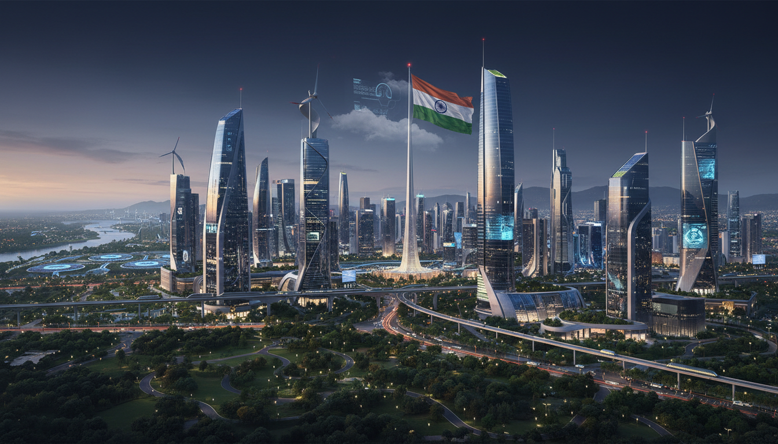
STRATEGIC SUMMARY
The Path Forward
India's governance transformation represents the most comprehensive democratic governance evolution in recorded history. From civilizational roots to digital leadership, from policy paralysis to execution excellence, India has established a new governance paradigm that synthesizes ancient wisdom with cutting-edge technology.
Civilizational Foundation
Digital Leadership
Global Impact
5,000 years of governance heritage informing modern systems
World's most comprehensive Digital Public Infrastructure
50+ countries adopting India Stack, G20 leadership
The foundation is set for India to emerge as a Viksit Bharat by 2047 — a developed, prosperous, and globally leading nation that demonstrates how democracy, diversity, and development can coexist and reinforce each other at scale.
Jai Hind.
Bharat Mata Ki Jai.

